Slide 1

Economics Course Code:CSER-1209
Md. Rabiul Karim
Assistant Professor
Department of Economics
Jagannath University, Dhaka
Email: rabiulkarimjnu@gmail.com

Slide 2
Theory of Cost

Slide 3
Concept of cost
Costs of a firm is incurred to establish the production unit and to purchase different factors of production (land, labor, capital, organization).
Cost of a firm (TC) is classified into two broad categories - Fixed cost (TFC) and Variable cost (TVC).
i.e. TC = TFC + TVC

Slide 4
Fixed cost and Variable cost
Fixed costs
Fixed costs are expenses that does not change in proportion to the activity of a business.
Fixed costs include overheads (rent, insurance-premium, interests), and also direct costs such as payroll (particularly salaries).

Slide 5
Fixed cost
Fixed cost does not change with the volume of production.
costs
100
TFC
O
Q

Slide 6
Variable costs
Variable costs
Variable costs change in direct proportion to the activity of a business such as sales or production volume.
In manufacturing, direct material costs, wages, fuel costs are examples of variable costs.

Slide 7

Output
(Q)
0
1
2
3
4
5
6
7
TFC
(£)
12
12
12
12
12
12
12
12
Total costs for firm X
TFC

Slide 8
Total costs for firm X
Output
(Q)
0
1
2
3
4
5
6
7
TFC
(£)
12
12
12
12
12
12
12
12
TVC
(£)
0
10
16
21
28
40
60
91
TFC

Slide 9
Total costs for firm X
Output
(Q)
0
1
2
3
4
5
6
7
TFC
(£)
12
12
12
12
12
12
12
12
TVC
(£)
0
10
16
21
28
40
60
91
TVC
TFC

Slide 10
Total costs for firm X
Output
(Q)
0
1
2
3
4
5
6
7
TFC
(£)
12
12
12
12
12
12
12
12
TVC
(£)
0
10
16
21
28
40
60
91
TC
(£)
12
22
28
33
40
52
72
103
TVC
TFC

Slide 11
Total costs for firm X
Output
(Q)
0
1
2
3
4
5
6
7
TFC
(£)
12
12
12
12
12
12
12
12
TVC
(£)
0
10
16
21
28
40
60
91
TC
(£)
12
22
28
33
40
52
72
103
TC
TVC
TFC

Slide 12
Average fixed cost
Average fixed cost
AFC = TFC/Q
where TFC = fixed cost, Q = total number of units produced.
The total unit cost of a product will decline as volume increases.

Slide 13
Average Fixed costs
Costs
AFC
O
Q

Slide 14
Average variable cost
Average variable cost (AVC) is the TVC of a firm divided by the total units of output (Q).
AVC = TVC/Q
costs
AVC
Y
O
Q

Slide 15
Average cost
Average cost (AC) is the TC of a firm divided by the total units of output (Q).
AC = TC/Q = AFC + AVC
costs
AC
Z
O
Q

Slide 16
Marginal Cost
The additional cost incurred to produce one additional unit of output is called the Marginal Cost (MC).
MC = dC/dQ

Slide 17
Marginal costs
MC
Diminishing marginal
returns set in here
Costs (£)
x
Output (Q)

Slide 18
Why is Marginal Cost Curve U-Shaped?
The marginal cost curve is U-shaped. Marginal cost is relatively high at small quantities of output - then as production increases, it declines - then reaches a minimum value - then rises.
This shape of the marginal cost curve is directly attributable to increasing, then decreasing marginal returns (the law of diminishing marginal returns).

Slide 19
Numerical Example
Q | TFC | TVC | TC | AFC | AVC | AC | MC
0 | 100 | 0
1 | 100 | 20
2 | 100 | 37
3 | 100 | 52
4 | 100 | 80
5 | 100 | 120
6 | 100 | 165

Slide 20
Numerical Example
Q | TFC | TVC | TC | AFC | AVC | AC | MC
0 | 100 | 0 | 100
1 | 100 | 20 | 120 | 100 | 20 | 120 | 20
2 | 100 | 37 | 137 | 50 | 18.5 | 68.5 | 17
3 | 100 | 52 | 152 | 33.33 | 17.33 | 50.67 | 15
4 | 100 | 80 | 180 | 25 | 20 | 45 | 28
5 | 100 | 120 | 220 | 20 | 24 | 44 | 40
6 | 100 | 165 | 265 | 16.67 | 27.5 | 44.17 | 45

Slide 21
Average and marginal costs
MC
AC
AVC
Costs (£)
z
y
x
AFC
Output (Q)

Slide 22
Discussion Questions
1. What do you mean by :
Fixed cost, Variable cost, Total Cost, Average Fixed Cost, Average Variable cost, Average total cost and Marginal cost (uses distinctive graphs)
2. Why is Marginal Cost Curve U-Shaped?
3.
Q | TFC | TVC | TC | AFC | AVC | AC | MC
0 |  |  | 3
1 |  | 0.30
2 |  |  | 3.80
3 |  |  | 4.50
4 |  | 2.40
5 |  |  |  |  | 0.70
6 |  |  |  |  |  | 1.30

Slide 23
4. Consider the following cost information for a fast food join: Fixed cost = $450
Quantity | Variable Cost
0 | 0
1 | 50
2 | 90
3 | 120
4 | 150
5 | 190
6 | 240
Construct a table and calculate the following: total cost, average fixed cost, average total cost, average variable cost and marginal cost.
Plot the average fixed cost, average total cost, average variable cost and marginal cost curves.
Using the cost curves you just plotted, explain the relationship between marginal cost and average total cost / average variable cost and marginal cost.

Slide 24
Theory of Production

Slide 25
Theory of Production
Production is a process that create/adds value or utility
It is the process in which the inputs are converted in to outputs.
Inputs
The factors of production such as Land, Labour, Capital, Technology ,etc
Outputs
The goods and service produced such as Soap, Car ,etc

Slide 26
Factors of Production
Land
Natural resources such as surface, mineral , air, rivers, sea, etc
Labour
Mental or physical effort done by a man
Man made goods used in the production process
Most mobile factor
Free gift of nature, fixed
Capital
Organization
Entrepreneur or coordinator of all other factors of production

Slide 27
Production Function
Production function means the functional relationship between inputs and outputs in the process of production.
It is a technical relation which connects factors inputs used in the production function and the level of outputs.
Q = f (Land, Labour, Capital, Organization, Technology, etc)

Slide 28
Inputs : Fixed inputs and Variable inputs
The factors of production that is carry out the production is called inputs.
Land, Labour, Capital, Organizer, Technology, are the example of inputs
Inputs Factors
Variable inputs
Fixed Inputs

Slide 29
Inputs : Fixed inputs and Variable inputs
Fixed inputs
Remain the same in the short period .
At any level of output, the amount is remain the same.
The cost of these inputs are called Fixed Cost
Examples:- Building, Land etc
( In the long run fixed inputs are become varies)
Variable inputs
In the long run all factors of production are varies according to the volume of outputs.
The cost of variable inputs is called Variable Cost
Example:- Raw materials, labour, etc

Slide 30
Various concept of production
Total Product (TP): is the total amount that is produced during a given period of time
Average Product (AP)- Ratio of Total Product and one variable inputs
Marginal Product (MP)– The rate of change of output as a result changes in one variable input

Slide 31

Production with One Variable Input
Short run Production Function with Labour as Variable factor
Labour (L)
Capital (K)
Total Output (TP)
Average Product (AP)
Marginal Product
(MP)
0
1
2
3
4
5
6
7
8
9
10
10
10
10
10
10
10
10
10
10
10
10
0
10
30
60
80
95
108
112
112
108
100

Slide 32
Production with One Variable Input
Short run Production Function with Labour as Variable factor
Labour (L)
Capital (K)
Total Output (TP)
Average Product
(AP)
Marginal Product
(MP)
0
1
2
3
4
5
6
7
8
9
10
10
10
10
10
10
10
10
10
10
10
10
0
10
30
60
80
95
108
112
112
108
100
-
10
15
20
20
19
18
16
14
12
10
10
20
30
20
15
13
4
0
-4
-8

Slide 33
D
112
Output per month
Total Product
C
60
B
A
Labor per month
3
4
8
30
Second Stage
Third Stage
E
20
First Stage
Average product
10
8
Labor per month
3
4
Marginal product

Slide 34
Stages in Law of variable proportion
First Stage: Increasing return
TP increase at increasing rate till the end of the stage.
AP also increase and reaches at highest point at the end of the stage.
MP also increase at it become equal to AP at the end of the stage.
MP>AP
Second Stage: Diminishing return
TP increase but at diminishing rate and it reach at highest at the end of the stage.
AP and MP are decreasing but both are positive.
MP become zero when TP is at Maximum, at the end of the stage
MP<AP.
Third Stage: Negative return
TP decrease and TP Curve slopes downward
As TP is decrease MP is negative. AP is decreasing but positive.

Slide 35
Law of Diminishing Marginal Returns
This law states that as additional units of an input are used in a production process, while holding all other inputs constant, the resulting increments to output (or total product) begin to diminish beyond some point (after B, in the bottom graph)
As the firm uses more and more units of the variable input with the same amount of the fixed input, each additional unit of the variable input has less and less of the fixed input to work and, after this point, the marginal product of the variable input declines

Slide 36
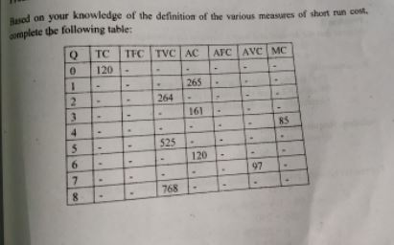
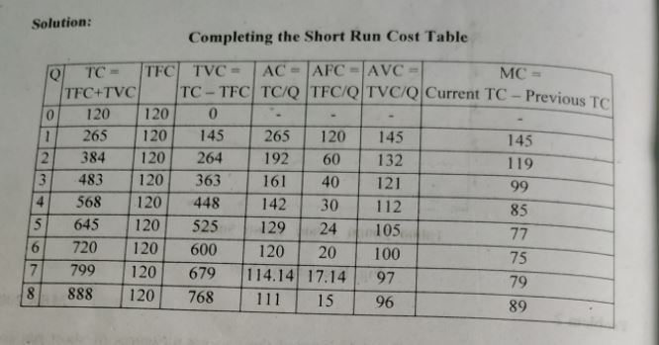
Problem 1

Slide 37
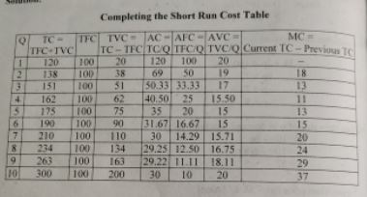

Slide 38
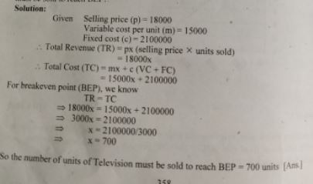

Problem 2

Slide 39
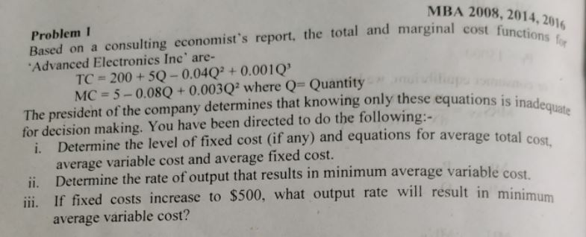
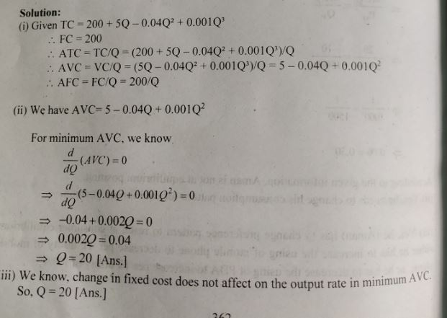
Problem 3

Slide 40
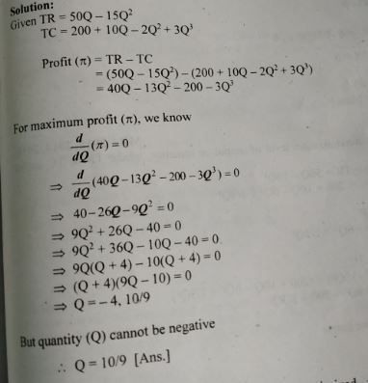

Problem 4

Slide 41
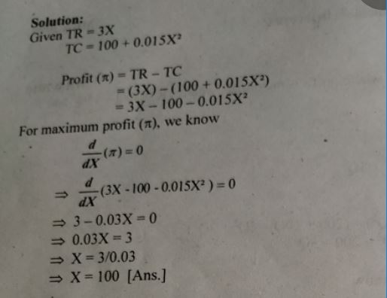
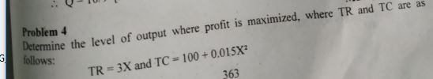
Problem 5

Slide 42
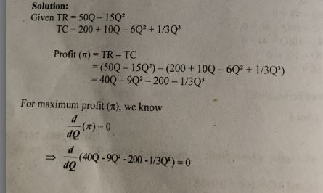
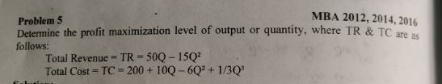
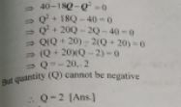
Problem 6

Slide 43
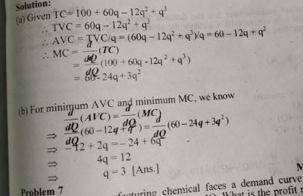

Problem 7

Slide 44
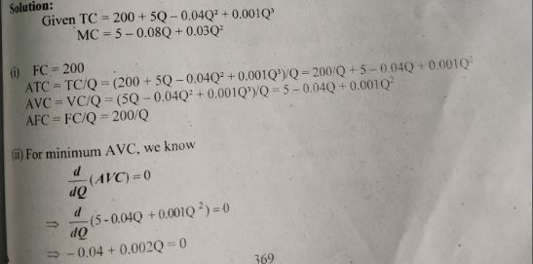
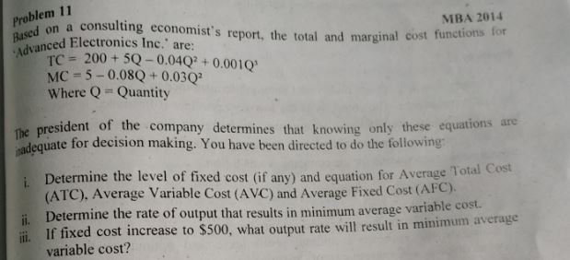
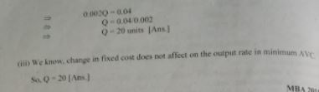
Problem 8

Slide 45
Thank You!

